Slide 1
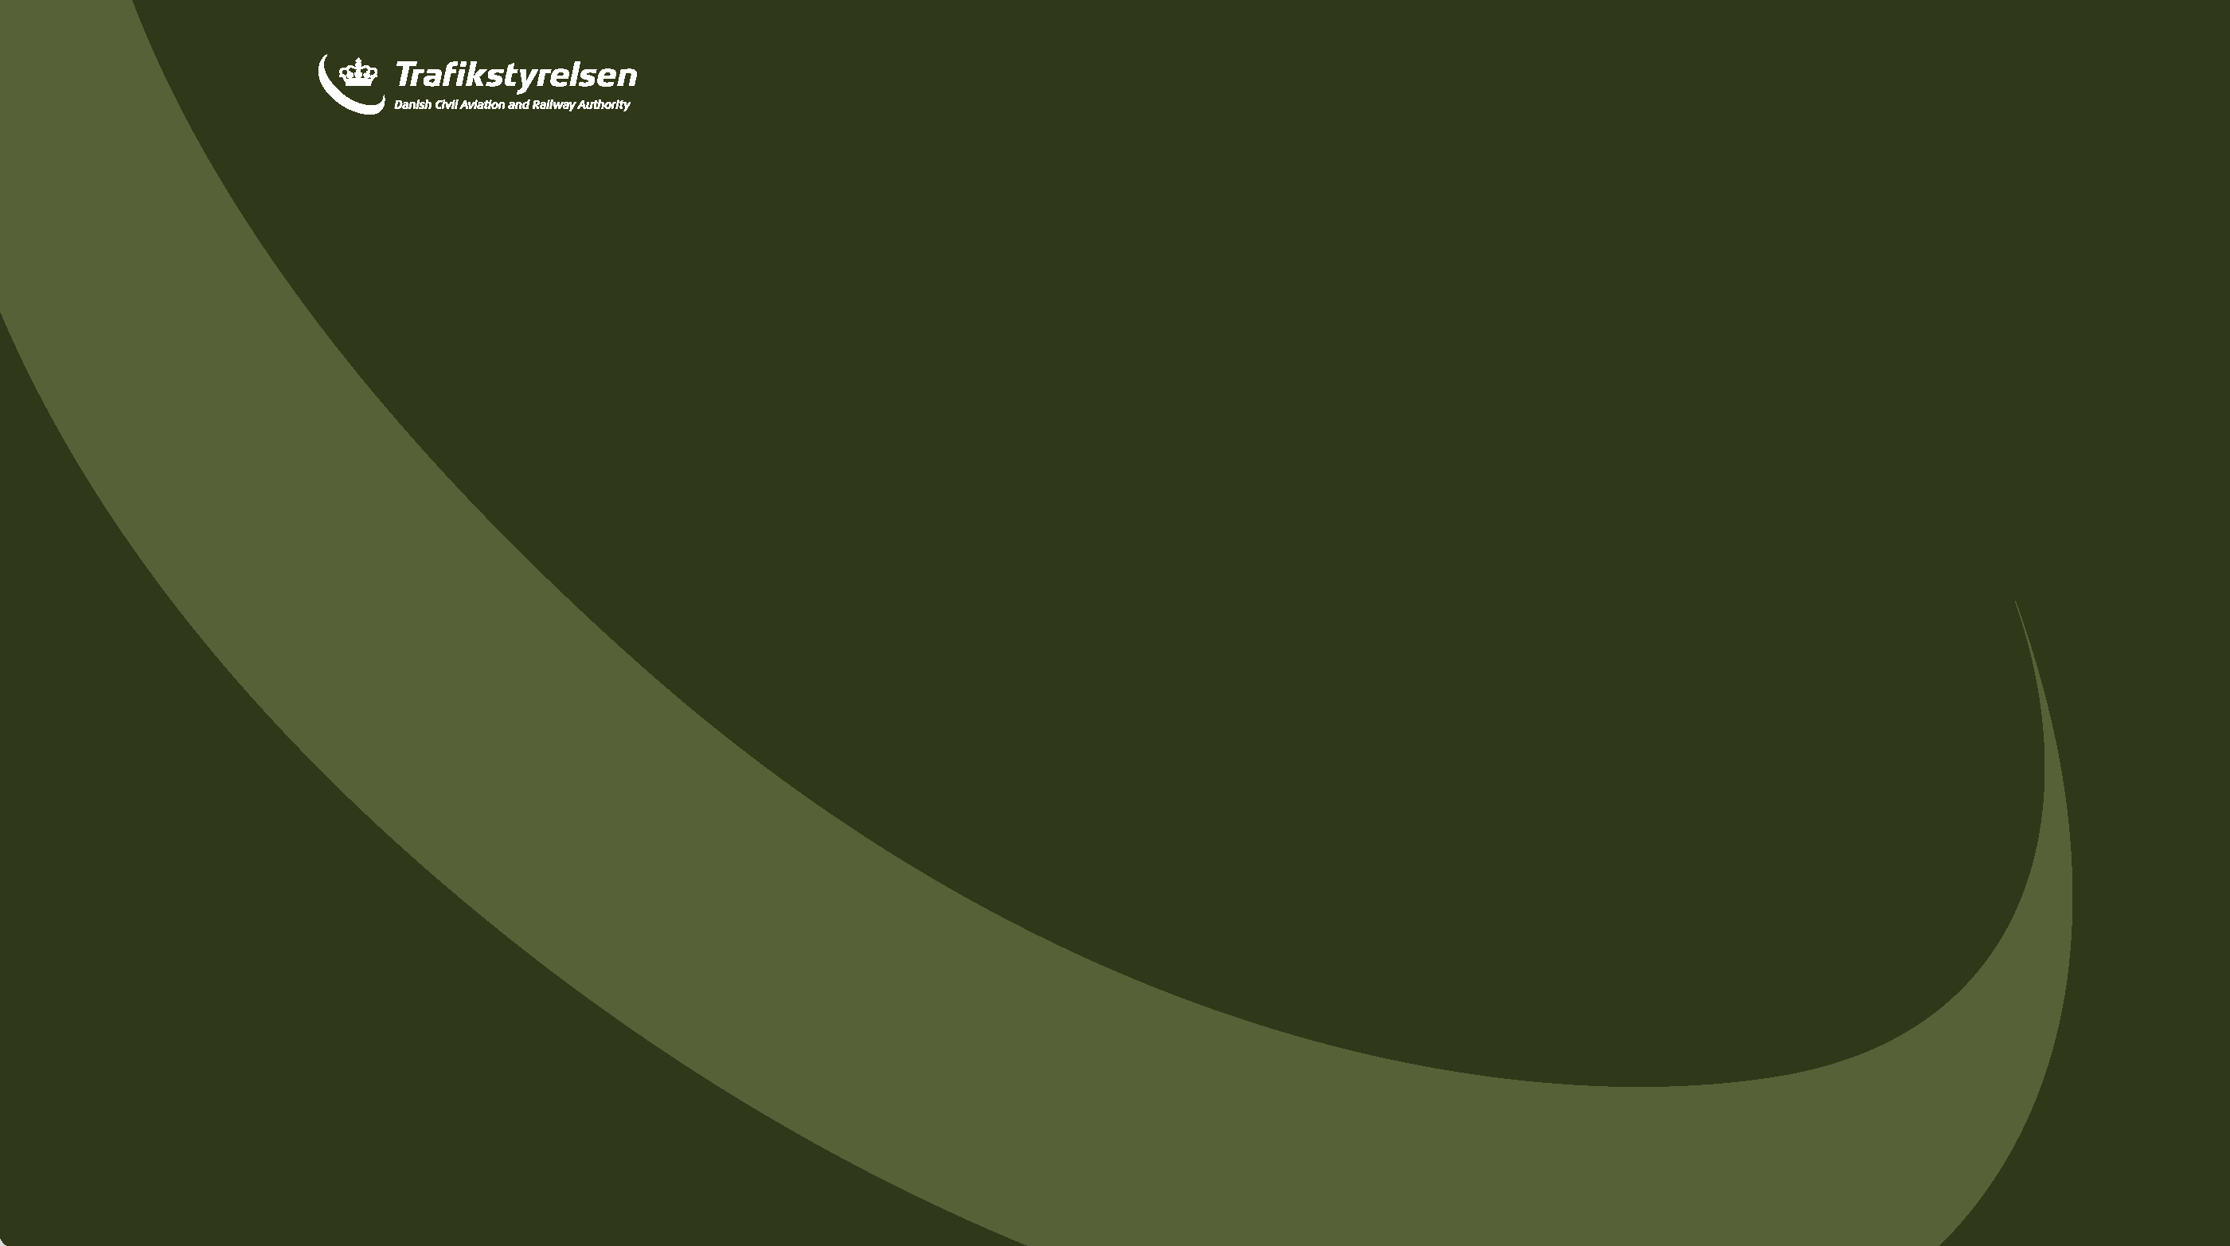
Conduct of a check
SEP(land) VFR proficiency check

Slide 2
Options
FCL.740.A Revalidation of class and type ratings – aeroplanes
(b) Revalidation of single-pilot single-engine class ratings
(1) SEP aeroplane class ratings and TMG class ratings. For the revalidation of SEP aeroplane class ratings or TMG class ratings, applicants shall:
(i) within the 3 months preceding the expiry date of the rating, pass a proficiency check in the relevant class in accordance with Appendix 9 to this Part with an examiner; or.

Slide 3
Cont…
(ii) within the 12 months preceding the expiry date of the rating, complete 12 hours of flight time in the relevant class, including the following:
(A) 6 hours as PIC;
(B) 12 take-offs and 12 landings;.

Slide 4
Cont…
(C) refresher training of at least 1 hour of total flight time with and to the satisfaction of a flight instructor (FI) or a class rating instructor (CRI) who shall select those flight exercises that allow the applicant to refresh their competence in safely operating the aircraft and applying normal, abnormal and emergency procedures. Applicants shall be exempted from this refresher training if they have passed any of the following, in any class or type of aeroplane:
(1) a class or type rating proficiency check;
(2) a skill test;
(3) an EBT practical assessment;
(4) an assessment of competence.

Slide 5
Refresher training
Procedure
https://www.examiner.dk/procedures/instructors
Form
https://www.examiner.dk/documents/2025/feb/fcl945-revalidation-of-classrating-sepland-sepsea-and-tmg .

Slide 6
Proficiency check
EDD ?
Part Aitcrew 1178/2011 ?
FEM ?
Examiner.dk ?
Other ?.

Slide 7
General
FCL.1000 Examiner certificates
(a) General Holders of an examiner certificate shall:
(1) hold, unless otherwise determined in this Annex, an equivalent licence, rating or certificate to the ones for which they are authorised to conduct skill tests, proficiency checks or assessments of competence and the privilege to instruct for them;
(2) be qualified to act as PIC in the aircraft during a skill test, proficiency check or assessment of competence if conducted on the aircraft.

Slide 8
Vested interests
FCL.1005 Limitation of privileges in case of vested interests
Examiners shall not conduct:
(a) skill tests or assessments of competence of applicants for the issue of a licence, rating or certificate to whom they have provided more than 25 % of the required flight instruction for the licence, rating or certificate for which the skill test or assessment of competence is being taken; and
(b) skill tests, proficiency checks or assessments of competence whenever they feel that their objectivity may be affected.

Slide 9
National administrative requirements pre check
EDD
https://www.examiner.dk/documents/2023/sep/examiner-edd
Examiner.dk
https://www.examiner.dk/general-information .

Slide 10
The check
Use of the FEM and examiner.dk procedures and guidance
https://aim.naviair.dk/
https://www.examiner.dk/procedures/fem .

Slide 11
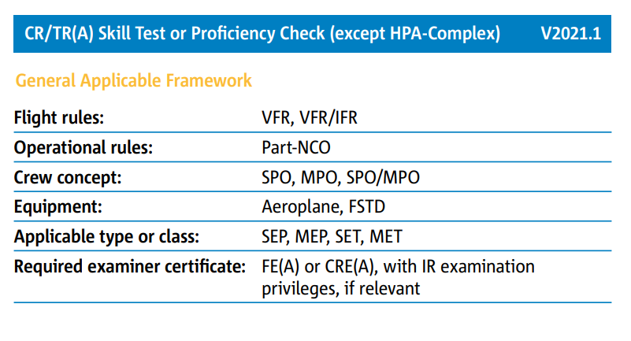
Overview of check

Slide 12
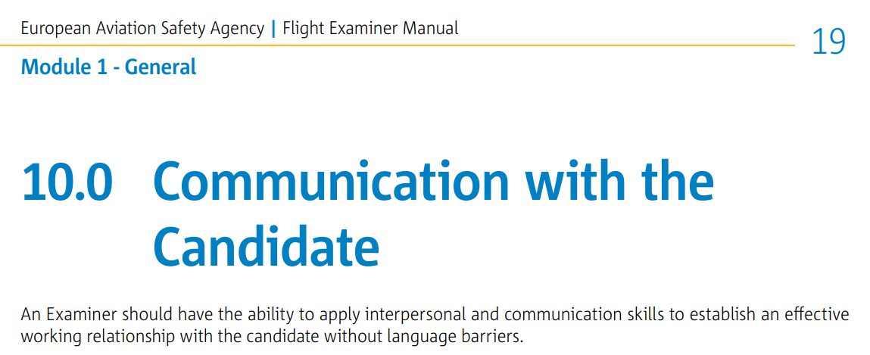
Meeting the candidate
Communication

Slide 13
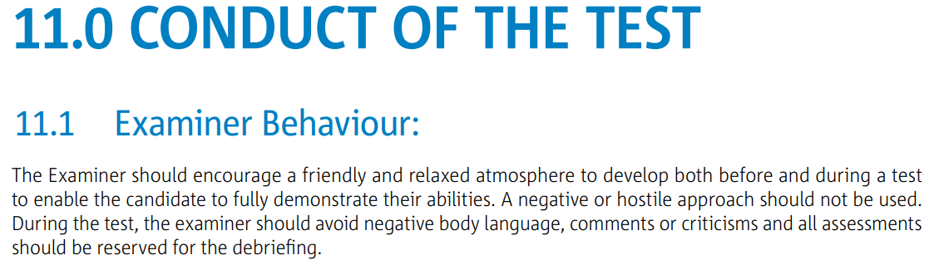
Atmosphere

Slide 14
Footprint
Pre-examination
15 min
Oral examination
45 min
Flight
GM FCL.1015
Debriefing
30 min
Administration
15 min

Slide 15
Pre examination
13.1 Gen
The briefing should cover the following:
1. Licensing and identification checks, as necessary;
2. The objective of the flight;
3. Test or check sequence;
4. Contents of exercise to be performed;
5. Operating procedures to be followed (for example operators manual);
6. Agreed speed and handling parameters (for example V-speeds, bank angle, power setting and approach
minima) as applicable;
7. Weather assessment;
8. Simulated weather assumptions (for example icing and cloud base);
9. Respective roles of the Candidate and the Examiner during the test (for example during emergency. Please
refer to subpart 9.0);
10. Administrative procedures (for example submission of flight plan);
11. Responsibility for the use of R/T, including simulated R/T;
12. The freedom for the ‘candidate’ to ask questions must be emphasised.

Slide 16
Cont…
3.0 Module 4.1 - CR TR SPA
Freedom for the Candidate to ask questions
• Purpose and aim of the test/check
• Applicable weather minimum (e.g. Part-NCO, NAA, ATO, or test requirements)
• Examiner has PIC responsibility; the Candidate acts autonomously as if he was the PIC
• Handling of radiocommunications during specific parts of the test
• Use of the sight-limiting device
• Examiner role-play in normal operations and simulated emergencies
• Engine failure-simulation (minimum safety height, handling of engine-controls).
• Handling of possible contingencies (technical, weather, ATC)
• Handling of actual emergencies (e.g. engine failure procedures, change of aircraft control)
• Pass, fail, and partial pass criteria, repeat items option, and examination termination rules.

Slide 17
Cont…
Module 4.1 - CR TR SPA, 2 Test Administration
Verify that the prerequisites are met
Passport or ID
• PPL(A) or higher
• Medical EASA Class 1 or 2, with IR checked if IR revalidation/renewal is included
• Radiotelephony privileges and language proficiency requirements
• EASA logbook, showing the relevant minimum experience and flight instruction
• Relevant CR/TR(A) skill test form filled, endorsed by the ATO if applicable
• Aircraft documents
• Current navigation charts, and database if applicable
• Insurance of aircraft covering check flights
• Specific equipment for the flight part (e.g. sight-limiting device)
Additionally for a renewal proficiency check:
• CR/TR refresher training completion certificate from an ATO.

Slide 18
Option (pre exam)
https://www.examiner.dk/documents/2024/template-pre-examination-mp-and-hpca-tests

Slide 19
Remember
Definitions:
"Proficiency check" means the demonstration of skill to revalidate or renew ratings or privileges, and including such oral examination as may be required.

Slide 20
Candidate Flight Briefing
The Examiner should allow the Candidate to brief uninterrupted; the Candidate shall conclude their briefingby making a go/no-go decision. The briefing should cover the following aspects:
• Timetable (e.g. slot planning, boarding time)
• Operational navigation flight plan
• Weather situation and forecast
• NOTAMs, including relevant local military restrictions, as applicable
• Fuel planning
• Mass and balance calculation
• Performance calculation
• ATC flight plan, if applicable
• Aircraft status and documents, including maintenance release
• Threat and Error Management aspects.

Slide 21
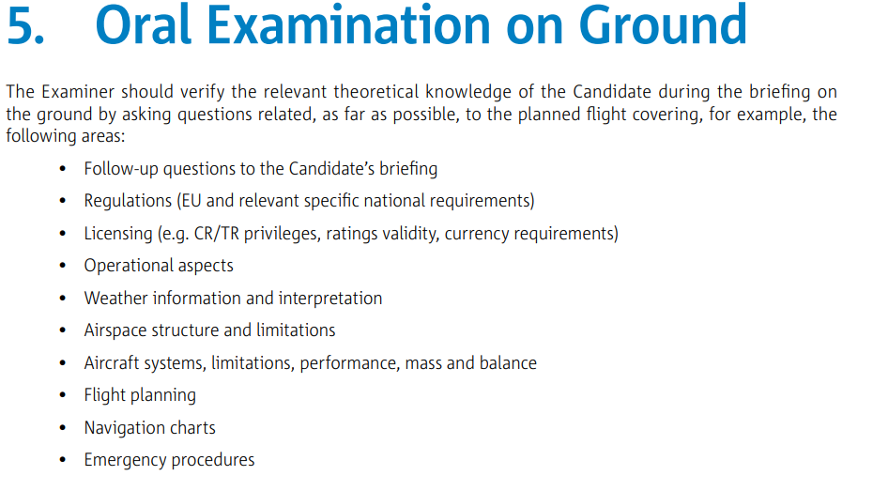

Slide 22
Oral examination
The pilot MUST know
The pilot SHOULD know
Would be BENEFICIAL to know.

Slide 23
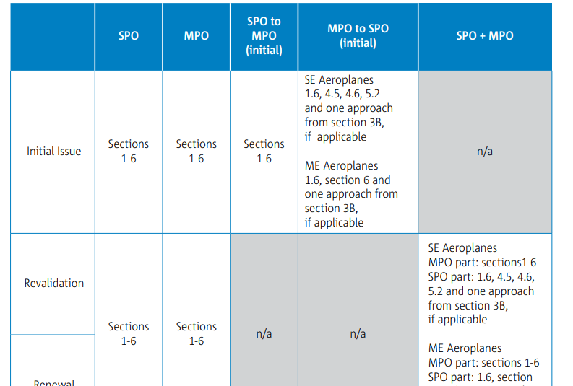
Sections to check

Slide 24
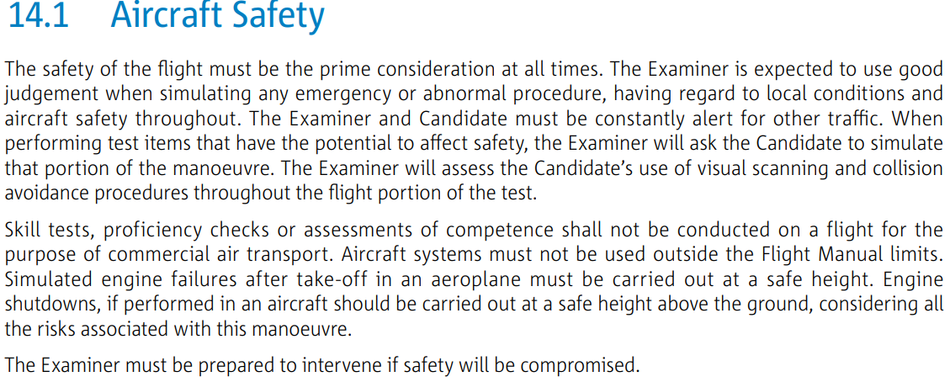
Safety General

Slide 25
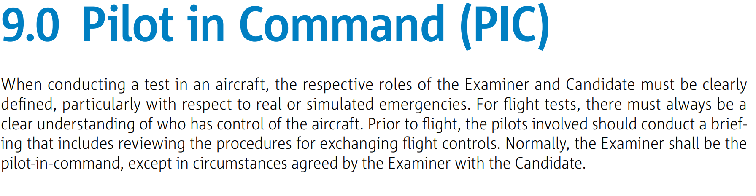
Cont…

Slide 26
Testform
https://www.examiner.dk/forms-and-documents/testforms
Front page A, B and C
Sections
Mandatory items
KAS and contents of each exercise
Failed items/sections
Repeats
Pass/Partial Pass/Fail/Incomplete
Comments, requirements (reason, disagree, training req).

Slide 27
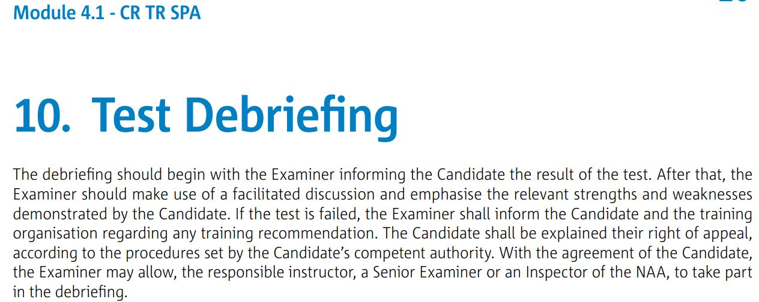
Debriefing

Slide 28
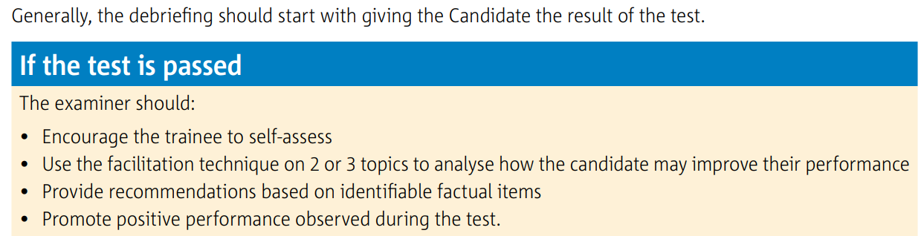
Debriefing

Slide 29
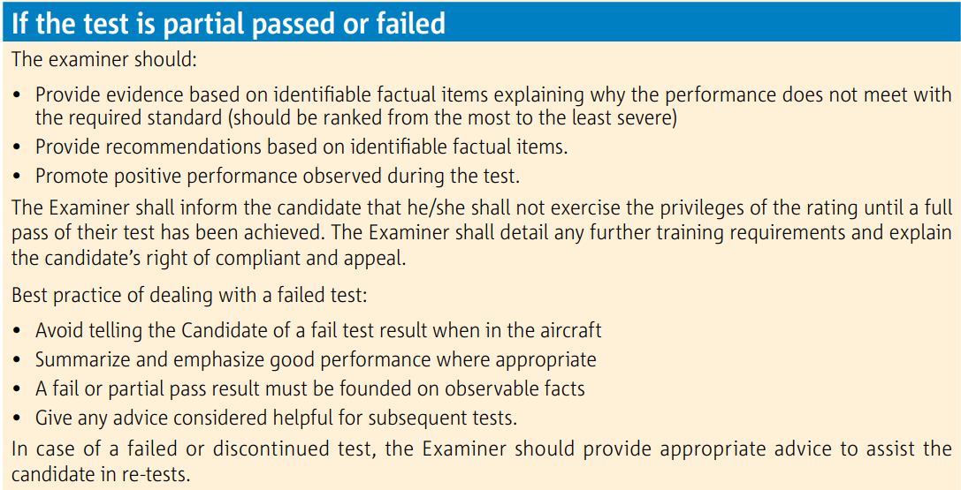
Debriefing

Slide 30
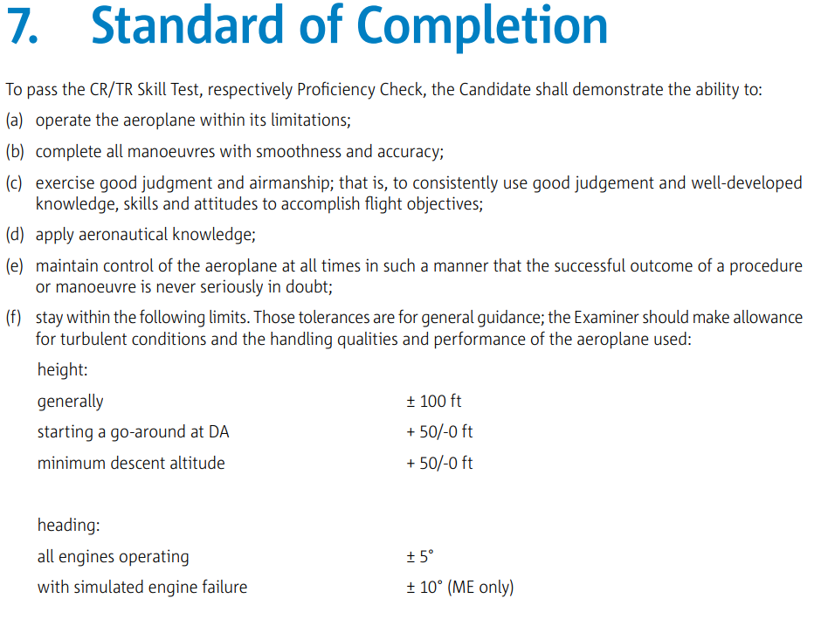
Pass or fail criteria

Slide 31
Guide
https://www.examiner.dk/documents/2019/maj/grading-system.

Slide 32
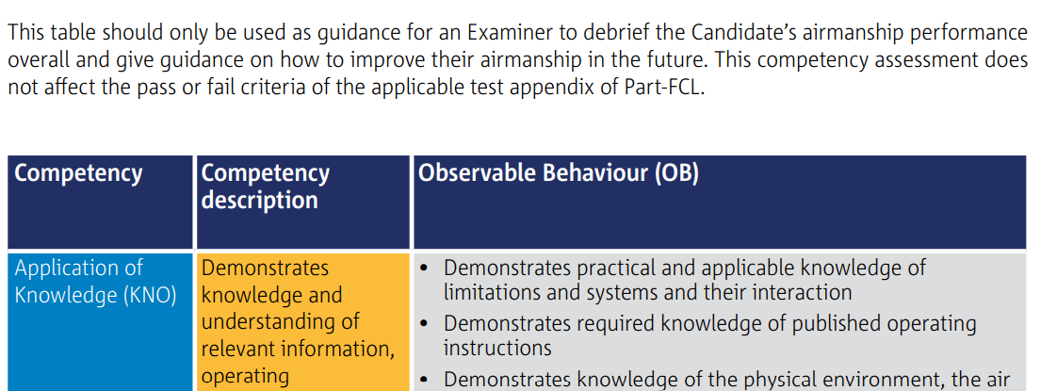
Root course

Slide 33
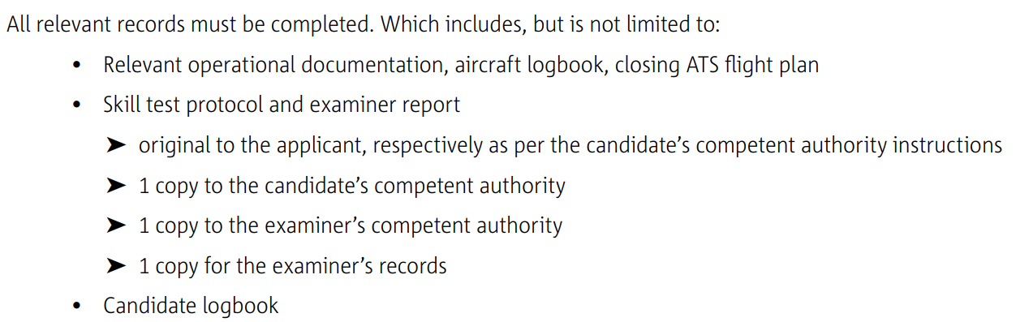
Post flight administration
Module 4.1 - CR TR SPA

Slide 34
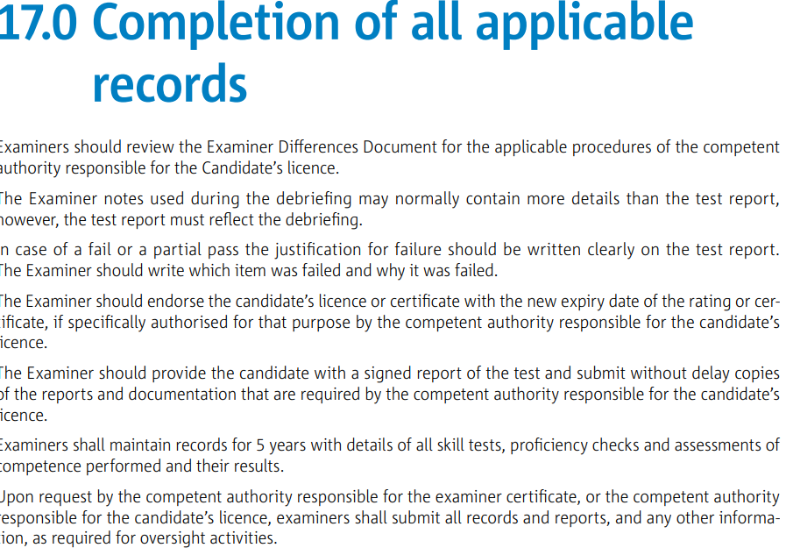
Post flight administration
Module 1 - Genera

Slide 35
Teaser
The pilot fails the proficiency check.
May the pilot fly his airplane to home base after the check?

